Slide 1
Azure Devops Repos
Branch Policies

Slide 2
Table of Contents
How to navigate to Branch Policies
Code Review options
Work item options
Comment resolution options
Merge type options
Build Validation(s)
Auto included Code Reviewers

Slide 3
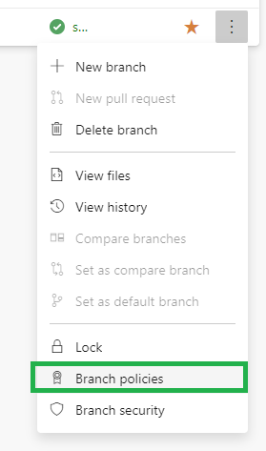
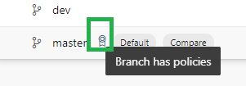
Intro to Branch Policies
Figure 1 : Click on vertical ellipses to expand more options.
Control policies such as minimum number of reviewers, linked work items for completion, build validation & more.
By default, a branch that has an active Branch Policy is locked.
Figure 3 : Once a branch policy is implemented on a branch, this icon will appear to inform you. You can also click on this icon to open options for Branch Policies moving forward.
Figure 2 : Select Branch Policies.

Slide 4
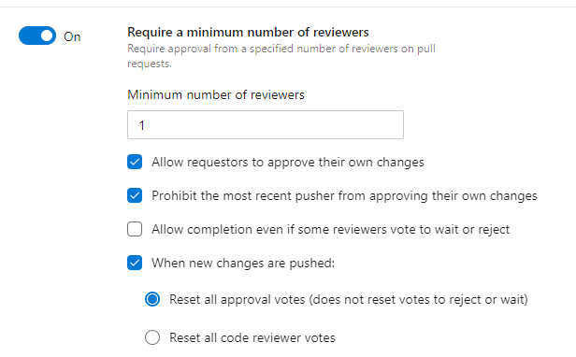
Code Review
Options exist to control conditions related to code review such as setting a minimum number of reviewers, resetting approvals based on new changes pushed, and etc.

Slide 5
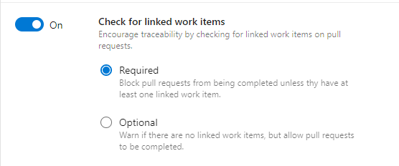
Check for Linked work items
Useful for auditing, it allows the option to enforce a policy in which work items are attached to a pull request.

Slide 6
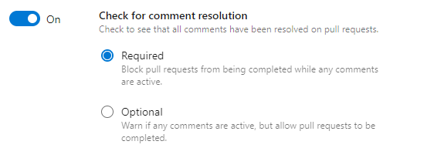
Comment Resolution
Allows the option to enforce all comments to be resolved before being able to approve the pull request.

Slide 7
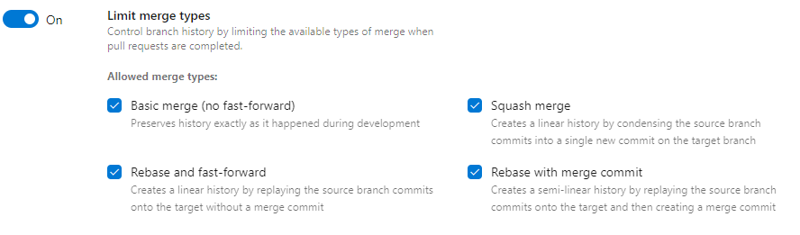
Limit Merge Types
Allows option to control what types of merges are allowed to take place.

Slide 8
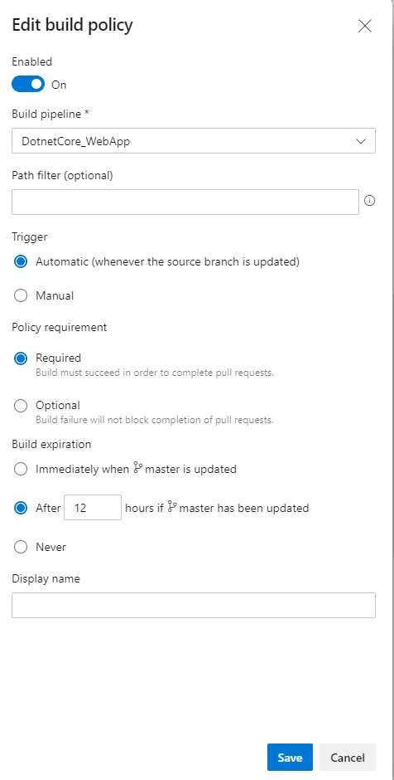
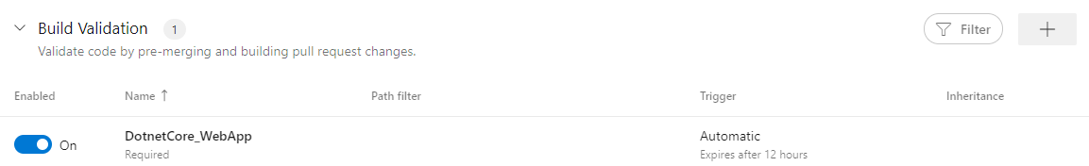
Build Validation
Allows you to add Continuous Integration (CI) builds to the pull request to ensure that code that is to be merged has a successful build tied to it.
Great for quality control.

Slide 9
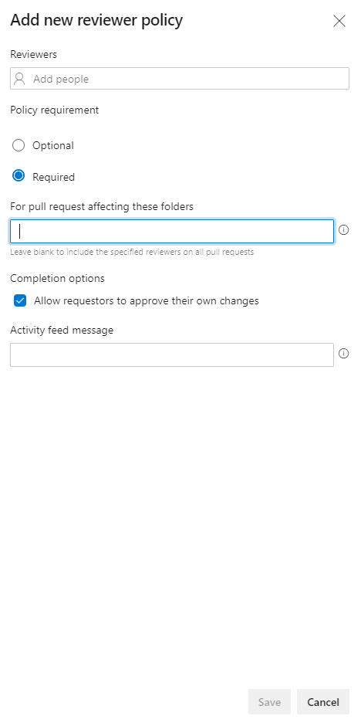
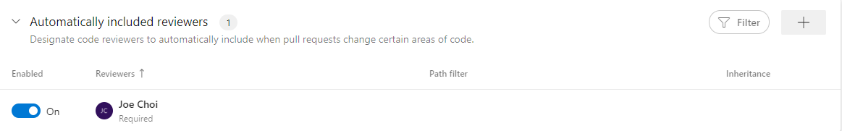
Auto included Reviewers
Forces the list of reviewers to be attached to every pull request. Great for auditing as well.
Even allows only certain folders to be reviewed by certain personnel for larger projects.

